Slide 1

Apache Mina
Dima Ionut Daniel

Slide 2
Contents
What is Apache Mina?
Why Apache Mina?
Mina Architecture
Mina Core
Mina Advanced
JMX Support
Spring Integration
Who uses Mina?
Conclusions
Bibliography

Slide 3

What is Apache Mina?
Apache MINA is a network application framework.
MINA stands for Multipurpose Infrastructure Networked Applications.
It helps users develop high performance and high scalability network applications easily.
It provides an abstract event-driven asynchronous API over various transports such as TCP/IP and UDP/IP via Java NIO.

Slide 4
Why Apache Mina?
The big difference between BIO (Blocking IO) and NIO (Non-Blocking IO) is that in BIO, you send a request, and you wait until you get the response.
On the server side, it means one thread wil be associated with any incoming connection, so you won't have to deal with the complexity of multiplexing the connections.
In NIO we to have to deal with the synchronous nature of a non-blocking system, wich means that your application will be invoked when some events occur.
Mina provides a common IO layer to an application that needs to communicate over TCP, UDP.
MINA makes the focus on the two parts that are important for the application: the applicative code and the application protocol encoding/decoding.

Slide 5
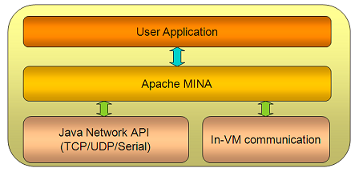
Mina Architecture
MINA is the glue between your application (be it a client or a server) and the underlying network layer, which can be based on TCP, UDP.
We just have to design your application on top of MINA without having to handle all the complexity of the newtwork layer.

Slide 6
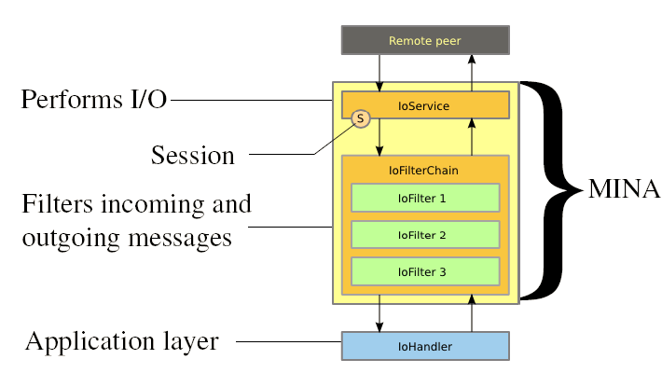
Mina Architecture (cont.)
MINA based applications are divided into 3 layers
I/O Service - Performs actual I/O
I/O Filter Chain - Filters/Transforms bytes into desired Data Structures and vice-versa
I/O Handler - Here resides the actual business logic

Slide 7
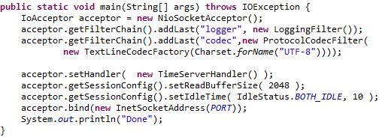
Mina Core
The IoAcceptor object is used for listening for incoming connections.
Filters needs to be added to the configuration.
A handler needs to be configured for the configuration.
Also session parameters configuration can be customized before starting the network service.

Slide 8
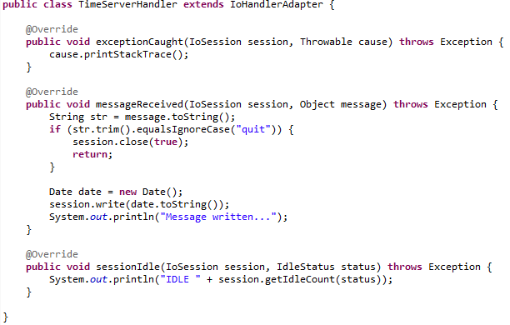
Mina Core (cont.)
The implementation of the IoHandlerAdapter defines certain situtations like: exceptions, receiving of the messages, session is idle.

Slide 9
Mina Core (cont.)
IoService is the base class supporting all the IO services, either from the server side or the client side.
It will handle all the interaction with your application, and with the remote peer, send and receive messages, manage sessions, conections.
IoFilter filters all I/O events and requests between IoService and IoHandler..
Custom IoFilters: LoggingFilters, ProtocolCodecFilter, SSLFilter, CompressionFilter, BlacklistFilter, KeepAliveFilter,etc.
The IoHandler handles all I/O events fired by MINA.
IoHandler methods: sessionCreated, sessionOpened, sessionClosed, sessionIdle, exceptionCaught, messageReceived, messageSent.

Slide 10
Mina Advanced
The IoBuffer represents a byte buffer used by Mina applications.
MINA does not use NIO ByteBuffer directly for two reasons:
It doesn't provide useful getters and putters such as fill, get/putString, and get/putAsciiInt() .
It is difficult to write variable-length data due to its fixed capacity
To allocate IoBuffer, we need to use one of the two allocate() methods.
The default buffer allocation is handled by SimpleBufferAllocator.

Slide 11
Mina Advanced (cont.)
The ProtocolCodecFactory class has useful methods like getEncoder, getDecoder that returns Encoder and Decoder custom implementations.
The ExecutorFilter class is used to spread the incoming events to a pool of threads. This will allow an application to use more effeciency the processors if some task is CPU intensive.
Apache Mina uses SLF4J(Simple Logging Facade for Java) as logging.

Slide 12
JMX Support
JMX is used for managing and monitoring java applications.
JMX enables MINA applications to perform the following:
Create/get MBean server.
Instantiate desired MBeans(IoAcceptor, IoFilter).
Register MBeans with MBean server.
Example:
IoServiceMBean mBean = new IoServiceMBean(acceptor);

Slide 13
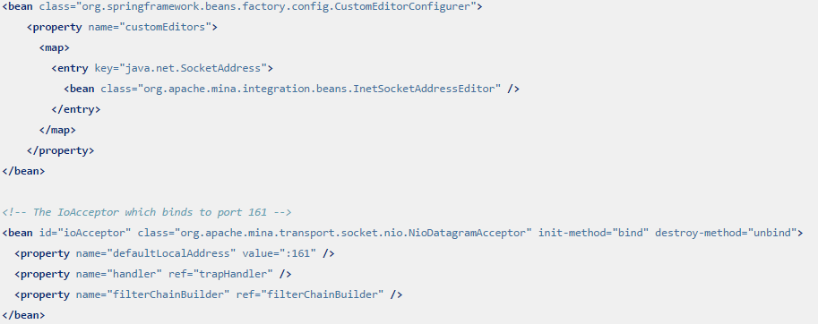

Spring Integration
Spring is a powerfull IoC(Inversion of Control) framework.
XML Spring file configuration can be used to create MINA applications.

Slide 14
Who uses Mina?
Apache Mina is used by frameworks like:
Apache Directory Project: LDAPv3, ChangePW, Kerberos, DNS, NTP, DHCP.
Xfire + AsyncWeb (SOAP over HTTP)
AMQP(Advanced Message Queuing Protocol)
QuickFIX/J (Financial Information eXchange)
RED5 Server (Macromedia Flash Media RTMP).
ObjectRADIUS
FreeCast (P2P media streaming)
Jstyx (NFS-like file sharing protocol)
Projects like: XMPP, SMS + MMS Gateways

Slide 15
Conclusions
We can create client and server scalable applications using Apache MINA.
Apache MINA is documented and easy to use.
Apache MINA can be integrated with Spring, PicoContainer.

Slide 16

Bibliography
https://mina.apache.org/

